Slide 1
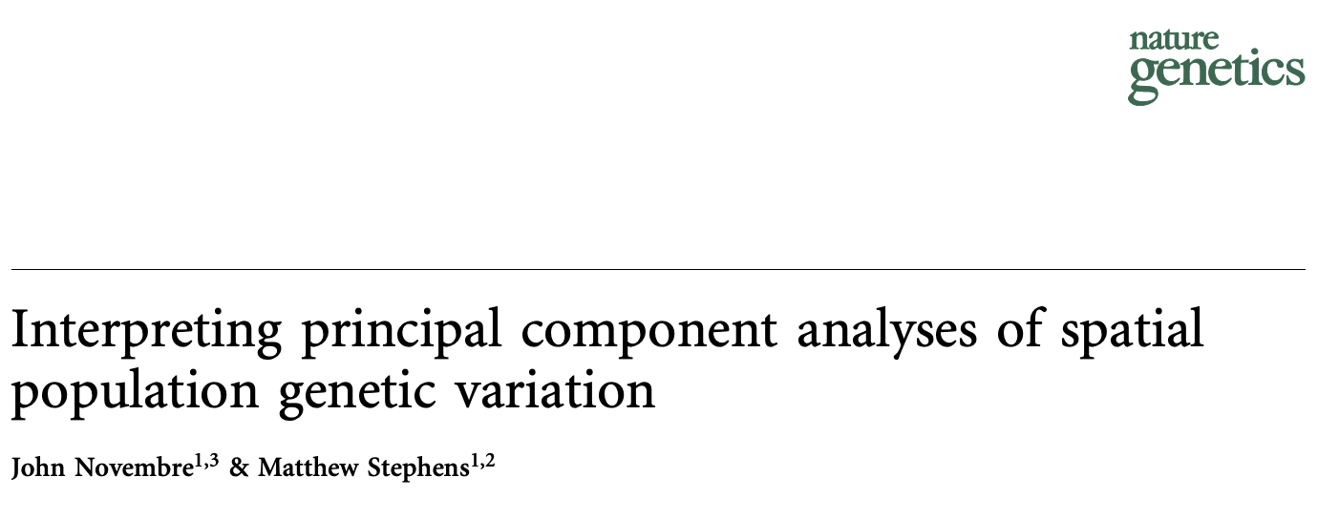

Slide 2
Overview
How can we come up with an efficient representation of the population genetics for a set of individuals or demes?
Given those representations, what do they tell us about the populations?

Slide 3
Overview
How can we come up with an efficient representation of the population genetics for a set of individuals or demes?
Given those representations, what do they tell us about the populations?

Slide 4
Overview
How can we come up with an efficient representation of the population genetics for a set of individuals or demes?
Given those representations, what do they tell us about the populations?
PCA

Slide 5
Basics of PCA: Motivation
Given:
N individuals
M features describing each individual (M large)
Find:
An efficient representation of each individual using only K features
One Individual
x₁
Many Individuals
y₁
≅
y
≅
x
N x K
N x M
y_{K}
x_{M}

Slide 6
Basics of PCA: Motivation
When picking our original M features, we were limited to what data we could directly collect (not the case with our new K features)
The problem can be framed as defining a new basis, one that maps our M-feature definition to a maximally informative K-feature definition of x_{i}
SOLVE FOR THIS
New Basis (KxM)
≅
N x M
N x K

Slide 7
Basics of PCA: Intuition
We will pick a basis that enables us to eliminate as much uncertainty as possible with each consecutive feature
If you had one feature to describe a point, you can knock out the most uncertainty by indicating the distance along the axis of maximum variance
After that, turn to the next largest source of variance that’s orthogonal to those already included
And so on…
Image by Nicoguaro, from Wikipedia

Slide 8
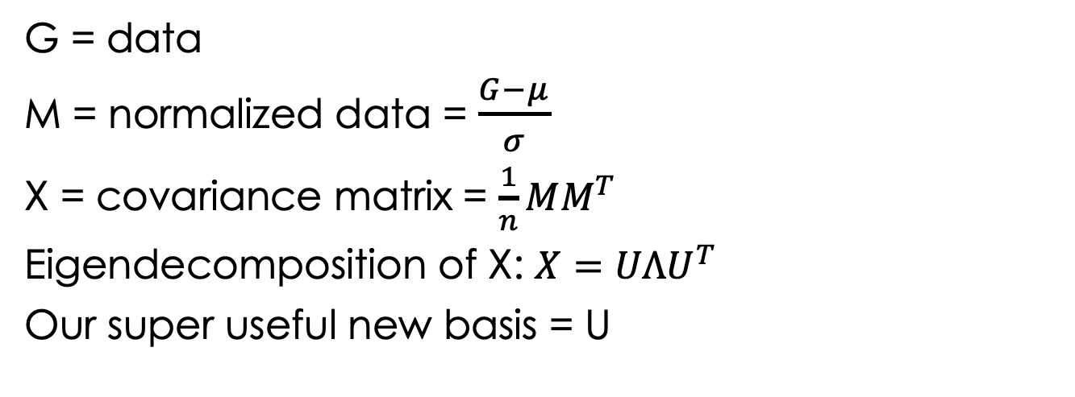
Basics of PCA: Details
It turns out that these maximally informative basis vectors are precisely the eigenvectors for the covariance matrix of the normalized data
G = data
M = normalized data = $\frac{G−μ}{σ}$
X = covariance matrix = $\frac{1}{n}MM^{T}$
Eigendecomposition of X: $X=UΛU^{T}$
Our super useful new basis = U
Image by Nicoguaro, from Wikipedia

Slide 9
PCA for Population Genetics
M allele counts @ biallelic loci
K x M
N individuals
N demes
≅
N x M
N x K
Loadings Matrix
Scores Matrix

Slide 10
Overview
How can we come up with an efficient representation of the population genetics for a set of individuals or demes?
Given those representations, what do they tell us about the populations?

Slide 11
Overview
How can we come up with an efficient representation of the population genetics for a set of individuals or demes?
Given those representations, what do they tell us about the populations?

Slide 12
PCA for Population Genetics
M allele counts/ frequencies @ biallelic loci
N individuals
N demes
N x M

Slide 13
Colors, Places, and Numbers
Eigenvectors will be of dimensionality n x 1, offering a mapping between principal components and individuals
Geographic Locations
Eigenvectors
Individuals
Josh
Ashton
Jessica
Tony
…
Location 1
Location 2
Location 3
Location 4
…

Slide 14
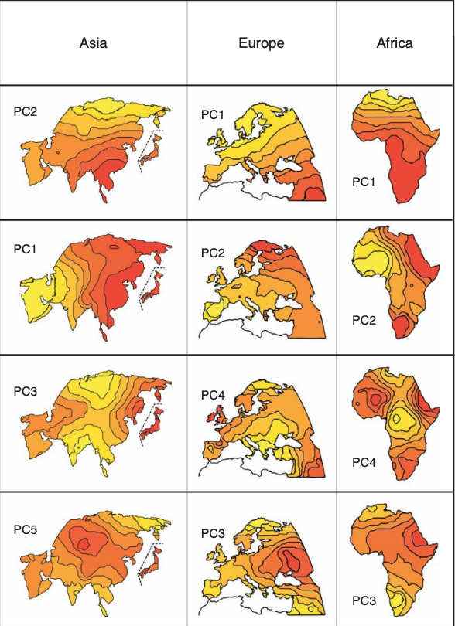
Colors, Places, and Numbers
Eigenvectors will be of dimensionality n x 1, offering a mapping between principal components and individuals
Geographic Locations
Eigenvectors
Individuals
Josh
Ashton
Jessica
Tony
…
Location 1
Location 2
Location 3
Location 4
…

Slide 15
An Observation
PC maps show that PC values vary in interesting ways across space

Slide 16
An Explanation
PC maps show that PC values vary in interesting ways across space
Cavalli-Sforza: these patterns correspond to migration events
Potential explanation for how farming technologies spread across Europe

Slide 17
Another Explanation
PC maps show that PC values vary in interesting ways across space
Cavalli-Sforza: these patterns correspond to migration events
Potential explanation for how farming technologies spread across Europe
Novembre & Stephens: This arises as a mathematical artifact of spatially varying data, no migration needed

Slide 18
The Method: Simulation
Take D demes (units of populations), 2N gametes each
In each generation, a proportion m of gametes swap places with a gamete in a neighboring population (neighbor structure is important)
1D neighboring structure: line
2D neighboring structure: grid

Slide 19
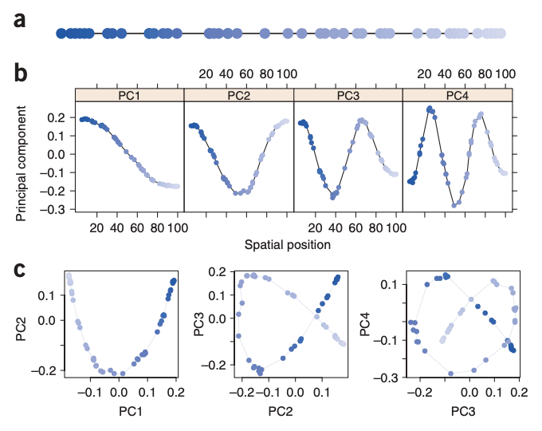
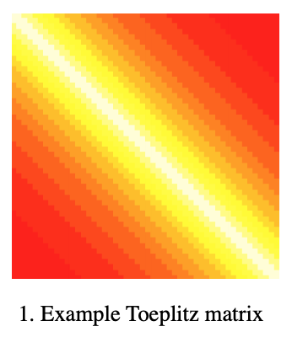
1D Neighborhood Structure
In a 1D neighborhood structure, covariance matrix has a “Toeplitz structure”
Element (i,j) depends only on j-i (distance between the two corresponding elements)
(from Fig 2a)
(from Fig S3b)

Slide 20
1D Neighborhood Structure
In a 1D neighborhood structure, covariance matrix has a “Toeplitz structure”
Element (i,j) depends only on j-i (distance between the two corresponding elements)
Eigenvectors are closely approximated by sinusoidal functions
Think Fourier (or Discrete Cosine) Transform

Slide 21
1D Neighborhood Structure
In a 1D neighborhood structure, covariance matrix has a “Toeplitz structure”
Element (i,j) depends only on j-i (distance between the two corresponding elements)
Eigenvectors are closely approximated by sinusoidal functions
Think Fourier (or Discrete Cosine) Transform
PC biplots produce Lissajous curves, particularly a “horseshoe pattern”

Slide 22
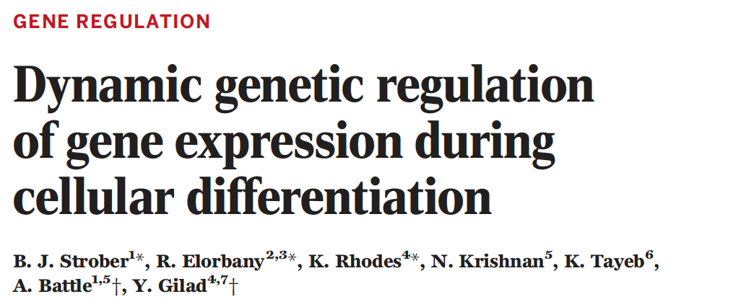
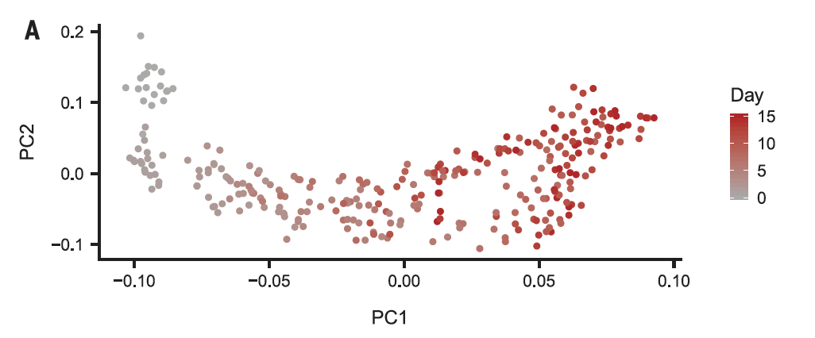
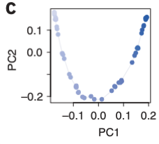
When would 1D arise?
Time-series data in a uniform environment

Slide 23
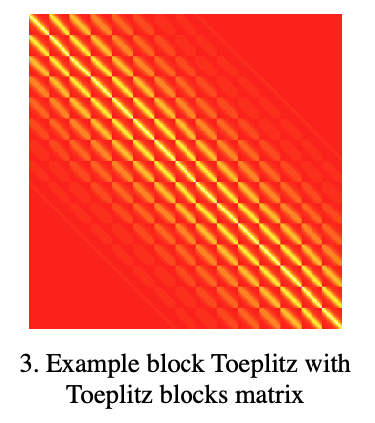
2D Neighborhood Structure
Take a 2D grid neighborhood structure
Covariance matrix has “block Toeplitz with Toeplitz blocks” structure
(from Fig S3b)

Slide 24

2D Neighborhood Structure
Take a 2D grid neighborhood structure
Covariance matrix has “block Toeplitz with Toeplitz blocks” structure
PC’s one and two are orthogonal gradients
(from Fig 1)

Slide 25
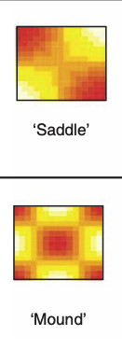
2D Neighborhood Structure
Take a 2D grid neighborhood structure
Covariance matrix has “block Toeplitz with Toeplitz blocks” structure
PC’s one and two are orthogonal gradients
PC’s three and four are saddle and mound structures
(from Fig 1)

Slide 26
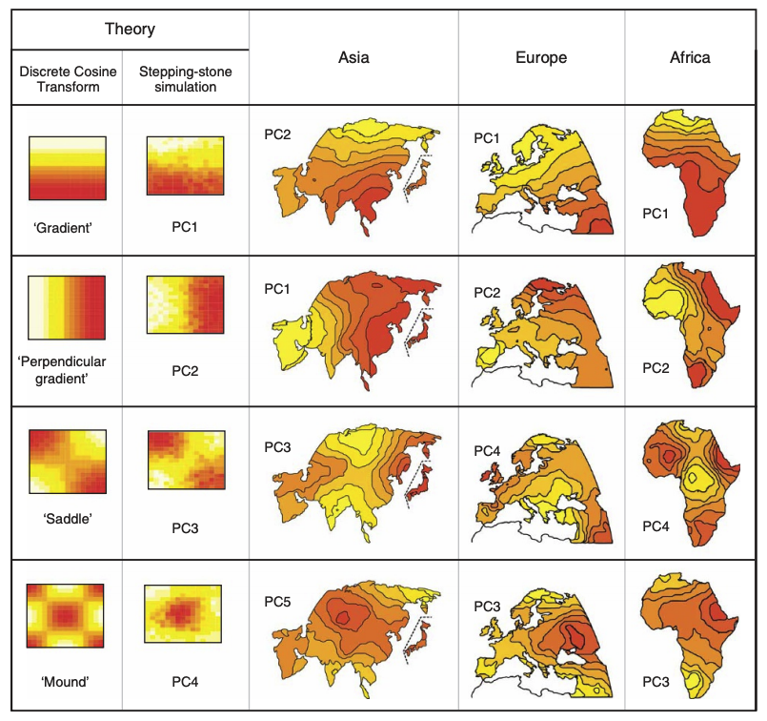
When would 2D arise?
On Earth!

